Slide 1






Sponsors – Thank you
We couldn’t do it without you.

Slide 2

why you should look at sqlcmd
Old Name - New CLI

Slide 3







mrrobsewell@outlook.com
Rob Sewell
He/Him
I was a SQL Server DBA with a passion for Powershell, Azure, Automation, and SQL (PaaS geddit?) (And a sense of humour (and a habit for writing inside braces)). Now I just help other people with those (not the braces bit).
SEWELLS CONSULTING LTD
Beard Twizzler
MICROSOFT MVP
DATA PLATFORM 2020 - 2022
AZURE (CDM) 2017 - 2022
INTERESTS
Heavy Metal Cycling , Heavy Metal automation, Community
robsewell.com

Slide 6

WHAT CAME BEFORe
SQLcmd
?
It's a long time ago NOW

Slide 7



Osql & Isql: Old Connectivity Tools
Osql & Isql:
Functionality:
Limitations:
Old command-line tools used to connect to SQL Server databases.
Provided basic functionality for querying and managing databases.
Lacked features such as parameters, DAC Performance
Osql & Isql were the tools GRANT AND Gianluca first used to connect to SQL Server databases.

Slide 8

November 2005 - sqlcmd
Where is this a picture of?
Over 17 years ago - SQLCMD released - Uses ODBC

Slide 9

November 2005 - sqlcmd
Where is this a picture of?
Over 17 years ago - SQLCMD released - Uses ODBC

Slide 10



sqlcmd - Incompatibility

Slide 11
sqlcmd - Incompatibility

Slide 12

GO-SQLCMD
aka.ms/sqlcmd
forked from
go-msqldb
written in Go
compiles into one exe
cross-platform
cross architecture
Shiny and New

Slide 13

Does it work with ALL old genres?
So Close!

Slide 14
Is It Backwards compatible?
So Close!

Slide 15
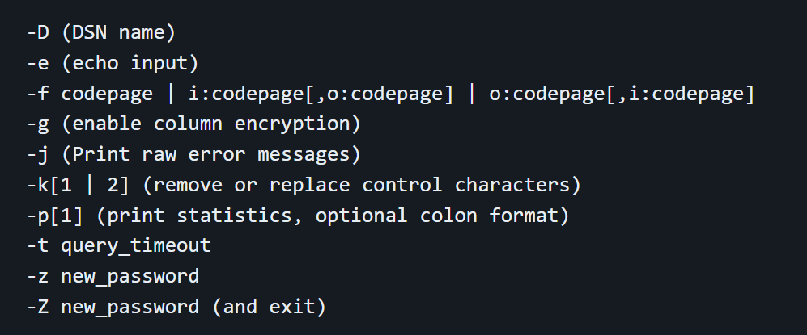
You said close?
-R (Use client regional settings)
IS removed.
Go doesn't provide this
-I (enable quoted identifiers)
IS removed.
(Use SET QUOTED IDENTIFIER OFF)
-P (password) was removed.
/ is not accepted as a flag specifier, only -

Slide 16





Linux
apt-get install sqlcmd yum install sqlcmd
winget install sqlcmd
brew install sqlcmd
choco install sqlcmd

Slide 17
Linux
apt-get install sqlcmd yum install sqlcmd
brew install sqlcmd
winget install sqlcmd
choco install sqlcmd

Slide 18
Linux
apt-get install sqlcmd yum install sqlcmd
winget install sqlcmd
brew install sqlcmd
choco install sqlcmd

Slide 19
Linux
apt-get install sqlcmd yum install sqlcmd
winget install sqlcmd
brew install sqlcmd
choco install sqlcmd

Slide 20
winget install sqlcmd
brew install sqlcmd
Linux
apt-get install sqlcmd yum install sqlcmd
choco install sqlcmd

Slide 21
Linux
apt-get install sqlcmd yum install sqlcmd
winget install sqlcmd
brew install sqlcmd
choco install sqlcmd

Slide 22


Slide 23

SHOW TIME

Slide 24


